Slide 1
HOT TOPICS IN EMPLOYMENT LAW
November 8, 2023

Slide 2
Disclaimer
The materials contained in this presentation were created by Laddey, Clark & Ryan, LLP, for informational purposes only and are not intended and should not be construed as a substitute for legal advice.
This seminar is not intended to create an attorney-client relationship between you and Laddey, Clark & Ryan, LLP.
This seminar is not intended to serve as an advertisement or solicitation.
All materials in this seminar are copyrighted © 2023 Laddey, Clark & Ryan, LLP.
The reproduction of any materials contained in this seminar without the permission of Laddey, Clark & Ryan, LLP, is prohibited.

Slide 3
TOPICS
1. CANNABIS IN THE WORKPLACE
2. EEOC workplace harassment guidance
3. Update: New Jersey wage and hour laws

Slide 4
CANNABIS IN THE WORKPLACE

Slide 5
New Jersey Marijuana Laws
Jake Honig Compassionate Use Medical Cannabis Act
Cannabis Regulatory Enforcement Assistance and Marketplace Modernization Act (CREAMMA).

Slide 6
Recreational Cannabis
In November 2020, New Jersey citizens voted to legalize marijuana for adult recreational use, approving the referendum by a 67% majority.
On Feb. 22, 2021, Governor Philip Murphy signed into law the “Cannabis Regulatory Enforcement Assistance and Marketplace Modernization Act,” or “CREAMMA”, which:
1. legalizes and regulates marijuana use and possession for adults aged 21 and over;
2. decriminalizes marijuana possession up to a certain quantity; and
3. clarifies marijuana use and possession penalties for individuals under 21 years old.

Slide 7
CREAMMA
CREAMMA legalizes and regulates marijuana use and possession for adults aged 21 and over; AND
Expressly prohibits an employer from subjecting an employee or applicant to any adverse action solely due to an individual’s positive drug test for marijuana.

Slide 8
CREAMMA
CREAMMA is not an employment law but includes language prohibiting employers from refusing to hire applicants because they do or do not consume marijuana AND solely due to the presence of the drug’s metabolites in their system (e.g., following a drug test).

Slide 9
CREAMMA
Under CREAMMA, “[n]o employer shall refuse to hire or employ any person or shall discharge from employment or take any adverse action against any employee with respect to compensation, terms, conditions, or other privileges of employment because that person does or does not smoke, vape, aerosolize or otherwise use cannabis items.” N.J.S.A. 24:6I-52.
Essentially creates a new “protected class” under New Jersey law for employees and job applicants who lawfully use recreational cannabis off premises and during non-working hours.

Slide 10
What can Employers Do?
Employees can be terminated for being under the influence of marijuana during work hours, regardless of whether the use is medical or recreational in nature.
Likewise, employers do not have to permit the use, sale, display, possession, or transfer of marijuana at work or during work hours.
Exceptions exist for employees that are subject to federally regulated positions or who work for employers with federal contracts, because both medical and recreational marijuana are still illegal under federal law.
In other words, if complying with the New Jersey state laws jeopardizes an employer’s federal contract, the employer is excepted from such compliance.

Slide 11
Federal or State Law???
New Jersey law diverges from federal law for medical marijuana AND recreational use.
Federal law makes it illegal to use, possess, grow and sell marijuana under the Controlled Substances Act.
There is no exception for the medical or so-called “recreational” use of marijuana in federal law.

Slide 12
Can employers require drug testing? What are the limitations?
Employee Protections: Drug Testing, Physical Evaluations by WIREs
With respect to drug testing, an employer may require an employee to undergo:
reasonable suspicion testing (reasonable suspicion of use at work or reasonable suspicion of impairment);
post-accident testing;
random testing; and
pre-employment testing.

Slide 13
Additional Guidance…
On September 9, 2022, the New Jersey Cannabis Regulatory Commission (CRC) has issued interim guidance for employers on steps they should take if they suspect an employee to be under the impairment of cannabis while performing work duties.
The CRC has also developed a Reasonable Suspicion Observed Behavior Report to go along with the interim guidance.
Available at: https://www.nj.gov/cannabis/newsevents/20220907.shtml

Slide 14
Additional Guidance on “Workplace Impairment”
Pursuant to N.J.S.A. 24:6I-52a(2)(a), the New Jersey Cannabis Regulatory Commission (“NJ-CRC”) is charged with prescribing standards for a Workplace Impairment Recognition Expert (“WIRE”) certification, based on education and training in detecting and identifying an employee’s usage of, or impairment from, a cannabis item or other intoxicating substance, and for assisting in the investigation of workplace accidents.
This NEW document is intended to serve as guidance until the CRC formulates and approves standards for WIRE certifications.

Slide 15
CRC Guidance
A scientifically reliable objective testing method that indicates the presence of cannabinoid metabolites in the employee’s bodily fluid alone is insufficient to support an adverse employment action.
BUT, such a test combined with evidence-based documentation of physical signs or other evidence of impairment during an employee’s prescribed work hours may be sufficient to support an adverse employment action.

Slide 16
CRC Guidance
• Utilize a uniform “Reasonable Suspicion” Observation Report that documents the behavior, physical signs, and evidence that support the employer’s determination that an employee is reasonably suspected of being under the influence during an employee’s prescribed work hours.

Slide 17
Reasonable Suspicion Observed Behavior Report
“Reasonable Suspicion” Observation Report Form is on CRC website - and the sample form is not cannabis-specific.
https://www.nj.gov/cannabis/documents/businesses/Business%20Resources/Workplace%20Impairment%20Guidance%20Sample%20Form.pdf

Slide 18
Discipline for Cannabis possession or use on the job
Absolutely permitted!
Just like alcohol is legal, you don’t have to permit it AT WORK; and
Just like alcohol, employees can be prohibited from being under the influence.

Slide 19
Points to Remember
Use of marijuana cannot be the only reason for any adverse employment action, such as termination or failure to hire or promote.
Employers may be obligated to accommodate medical marijuana patients, if such an accommodation is possible and would not pose an undue hardship on the employer.
Medical marijuana patients may also be entitled to reimbursement of the expenses associated with such treatment under an employer’s workers’ compensation plan.

Slide 20
What Employers Can and Can’t Do
Employers need not tolerate the possession of, use of, or an employee being under the influence of, cannabis—legal or not—in the workplace during working hours.
Employers may not take adverse action against an employee solely because that employee uses recreational or medicinal marijuana outside of work during non-working hours.
Employers may not solely rely upon—as justification for taking an adverse action—an employee’s prior arrest, charge, conviction or adjudication of delinquency, for certain cannabis-related expunged offenses.

Slide 21
MORE of What Employers Can and Can’t Do
Employers need not commit any act that would cause them “to be in violation of federal law, that would result in a loss of a licensing-related benefit pursuant to federal law, or that would result in the loss of a federal contract or federal funding.”
If an employer has a drug testing policy and an employee or job applicant tests positive, the employer must offer an opportunity to present a legitimate medical explanation, provide written notice of the right to explain, and afford three working days to the employee to explain or provide a retest.
Employers may still test - but include scientifically reliable objective testing methods and procedures and include a physical evaluation in order to determine an employee’s state of impairment. USE the NEW Form.

Slide 22
DRUG AND ALCOHOL POLICIES
Consider timing:
Pre-employment illegal drug testing;
NOT for cannabis
Reasonable suspicion drug and alcohol testing; and
Post-accident and follow-up illegal drug and alcohol testing
NO MORE RANDOM TESTING
Employees with Commercial Driver’s License (“CDL”) are different

Slide 23
THE EEOC WORKPLACE HARRASMENT GUIDANCE

Slide 24
New Updates to a Crucial Document
On September 29, the EEOC published their first update to their Enforcement Guide on Harassment in the Workplace (in 30+ years).
Goal is to provide clarity regarding existing legal requirements in light of the recent increase in sexual and racial harassment cases in recent years.
While not governing law if it becomes official, it would still be frequently referenced by the EEOC, attorneys, and the court.

Slide 25
Quick Background
In 1986, the U.S. Supreme Court issued Meritor Savings Bank v. Vinson = workplace harassment can constitute unlawful discrimination under Title VII of the 1964 Civil Rights Act. Since then, claims of harassment in the workplace have become a serious matter for employers.
EEOC first released proposed guidance on workplace harassment in 2017 amidst the #MeToo movement, but the proposal was never finalized.
The proposed guidance was open for public review and comment until November 1st. At this time, barring any litigation or unforeseen challenges, these guidance should be adopted in the first quarter of 2024.

Slide 26
Broad Protections for LGBTQ+ Workers
The new guidance includes provisions against harassment of LGBTQ+ workers, following the decision in Bostock v. Clayton County to claims of harassment based on sexual orientation and gender identity.
Examples of harassment under the new guidance:
Denial of access to a bathroom consistent with the individuals gender identity;
Intentional and repeated mis-genderding of an individual;
Any harassment of an individual because they do not present in a manner consistent with their gender stereotypes.

Slide 27
Anti-Bias Laws and Pregnancy Related Decisions
The definition of sexual harassment has been broadened to include pregnancy, childbirth, and other “related medical conditions.”
Employees would be protected against discrimination surrounding decisions related to pregnancy, including lactation, contraceptive choices, and the decision to have an abortion, among others.
Opposition has been filed by certain interest groups concerning the inclusion of abortion under “sex-based harassment”

Slide 28
Protection for Religious Expression
Along with accommodating employees’ sincerely held religious beliefs pursuant to Title VII, the guidance now makes clear that employers also have a duty to protect workers against religiously motivated harassment.
The EEOC clarifies the above and states that employers are not required to accommodate religious expressions that “creates” or “reasonably threatens to create” a hostile working environment.
“If a religious employee attempts to persuade another employee of the correctness of his beliefs, the conduct is not necessarily objectively hostile. If, however, the employee objects to the discussion but the other employee nonetheless continues, a reasonable person in the complainant’s position may find it to be hostile.”

Slide 29
“Virtual” Harassment
Guidance recognizes that harassment can occur virtually.
If conduct occurs during the virtual work environment and communicated by email, instant message, videoconference, or other online technology, it can still violate Title VII.
According to the guidance, social media posts on a personal social media page could contribute to a hostile work environment if an employee learns about the post directly or other coworkers see the comment and discuss it at work.
HOME IS BEING BROUGHT INTO OFFICE
The proposed guidance confirms that sexist, racist, or otherwise discriminatory speech communicated via these platforms is considered harassment.

Slide 30
Anti-Harassment Policies
Effective policies:
Defines what conduct is prohibited;
Is widely disseminated;
Is comprehensible to workers, including those who the employer has reason to believe might have barriers to comprehension, such as employees with limited literacy skills or limited proficiency in English;
Requires that supervisors report harassment when they are aware of it;
Offers multiple avenues for reporting harassment, thereby, allowing employees to contact someone other than their harassers;
Clearly identifies accessible points of contact to whom reports of harassment should be made and includes contact information; and
Explains the employer’s complaint process, including the process’s anti-retaliation and confidentiality protections

Slide 31
Complaints
Effective complaint process provides for:
Prompt and effective investigations and corrective action;
Adequate confidentiality protections; and
Adequate anti-retaliation protections

Slide 32
Training
Explains the employer’s anti-harassment policy and complaint process, including any alternative dispute resolution process, and confidentiality and anti-retaliation protections;
Describes and provides examples of prohibited harassment, as well as conduct that, if left unchecked, might rise to the level of prohibited harassment;
Provides information about employees’ rights if they experience, observe, become aware of, or report conduct that they believe may be prohibited;
Provides supervisors and managers information about how to prevent, identify, stop, report, and correct harassment, such as actions that can be taken to minimize the risk of harassment, and clear instructions for addressing and reporting harassment that they observe, that is reported to them, or that they otherwise become aware of;
Tailored to the workplace and workforce;
Provided on a regular basis to all employees; and
Provided in a clear, easy-to-understand style and format

Slide 33
What should employers do?
Consider the following steps to protect your interests:
Review handbooks and policies
Train your employees
Train supervisors

Slide 34
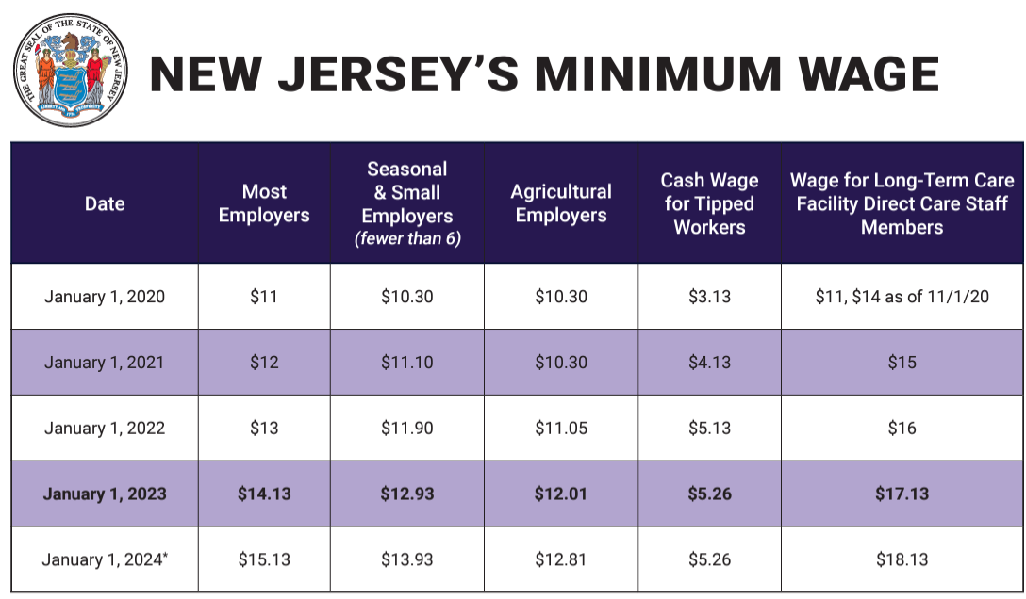
Update: New Jersey Wage and hour laws

Slide 35
New Jersey Wage and Hour Laws
Federally? The minimum wage is still $7.25 per hour.
New Jersey has been on a defined climb in recent years with a goal of reaching $15.00 per hour.

Slide 36
Changes to Minimum Wage Standards
With certain exceptions, minimum wage of $15.13 per hour (1/1/2024).
Under the law, seasonal and small employers (<6 employees) will increase to $13.73 per hour on 1/1/2024, up from $12.93.
Agricultural workers are guided by a separate minimum wage timetable and given until 2027 to reach the $15/hour minimum wage. Employees who work on a farm for an hourly or piece-rate wage will see their minimum hourly wage increase to $12.81, up from $12.01.

Slide 37
Minimum Wage For Tipped Employees
Minimum allowable cash wage remains at $ 5.26 per hour.
“Tip credits” are acceptable to reach state or federal minimum wage.
Employers are able to now claim a $9.87 tip credit, an increase of $1 from 2023.
Tip credit is not the same as “tip pooling”
Employers/managers are not allowed to participate in any tip pooling structure
Notes:
Tip credits are a way to include gratuities in minimum wage calculations. They allow an employer to credit a portion of an employee's tips toward the employer's obligation to pay minimum wage. Tip credits are not deducted from employees' pay; instead, if permitted to take a tip credit employers may claim a certain amount against their minimum wage requirement.
Tip Pool: Again, Employers may NOT keep any amount of tips. Also, any managers/supervisors cannot participate in that pool.
Voluntary participation: Employees must voluntarily participate in the tip pooling arrangement. Employers cannot require employees to contribute to the tip pool or mandate specific tip-sharing amounts.

Slide 38
Minimum Wage Cont.
Common Issues:
Deductions from pay cannot reduce wage below minimum wage
The “working lunch”
“Rounding” meal breaks
Automatic meal break deduction

Slide 39
In Summary..
Remember: All employees are entitled to wage and overtime unless they are correctly classified as “exempt.”
Minimum wage: Higher of federal or state minimum wage ($15.13 for most employees starting on 1/1/2024).
Overtime: Time-and-a-half for all hours over forty per week
Exemptions: Exempt employees are not subject to overtime or minimum wage
Salary basis: pay does not fluctuate
Salary amount: $684 per week/$35,568
Job duties: executive, administrative, professional, outside sales

Slide 40
Upcoming Employment Seminars in 2024
February 27, 2024 – Cannabis Webinar
May 14, 2024 – HR Boot Camp
September 17, 2024 – Privacy Rights and Internal Investigations Webinar
November 12, 2024 – End-of-Year Policy Review Webinar

Slide 41
Connect with Laddey, Clark and Ryan, LLP
Like us Connect with us Follow us

